Slide 1
Tungsten Support for Suppliers
August 2018
Tungsten vs MSD Support for suppliers

Slide 2


Tungsten Support vs. MSD Support
Tungsten Supplier Support
Technical issues
Problems with invoice submission
Support related to Web Form / Integrated Solution
Reporting
Support Ticket Creation:
    https://portal.tungsten-network.com/Forms/NewHelpSupport.aspx
Tunsten phone support
    (lines are open from 10am – 8pm AET)
The phone number for Tungsten support can be found here:
https://www.tungsten-network.com/uk/contact-us/
MSD Support – PtP Resolution Center
Missing PO on the Network
Additional information related to Payments
Contacts: overview per country provided in attached excel file

Slide 3
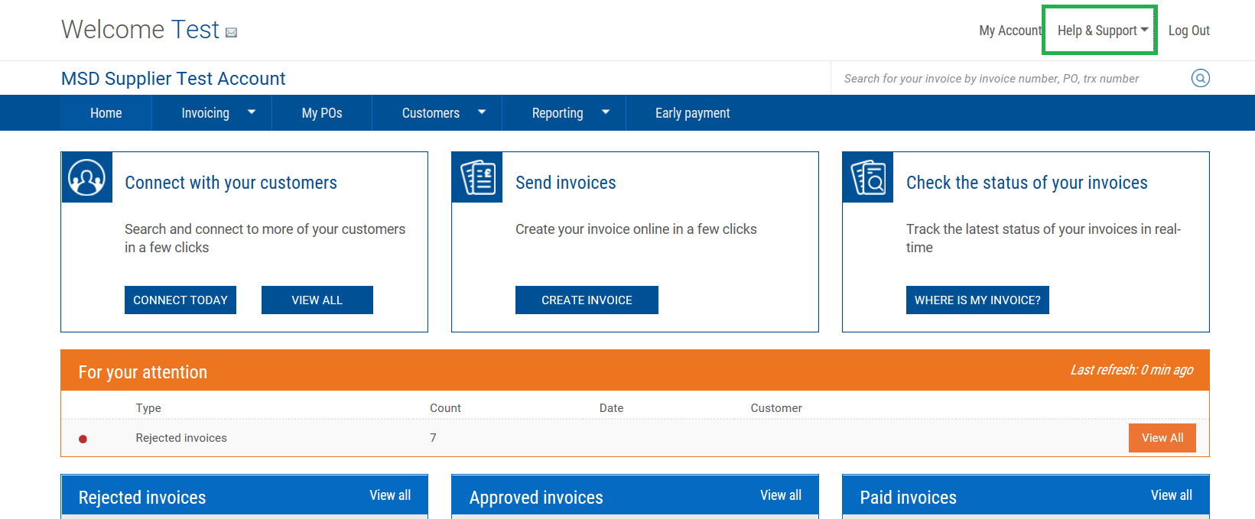
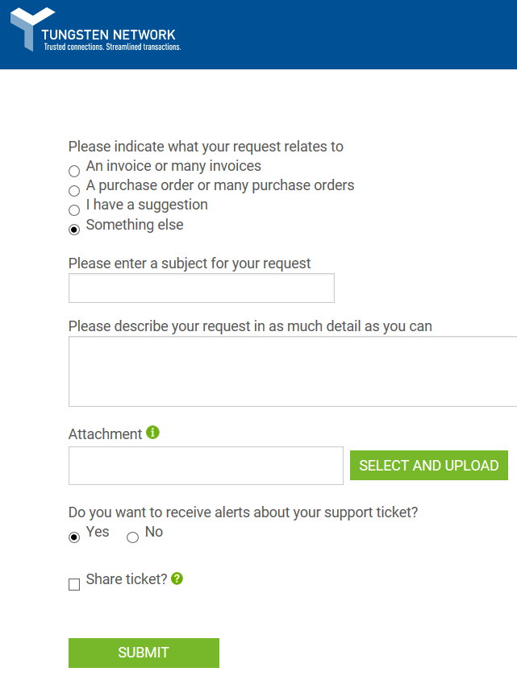
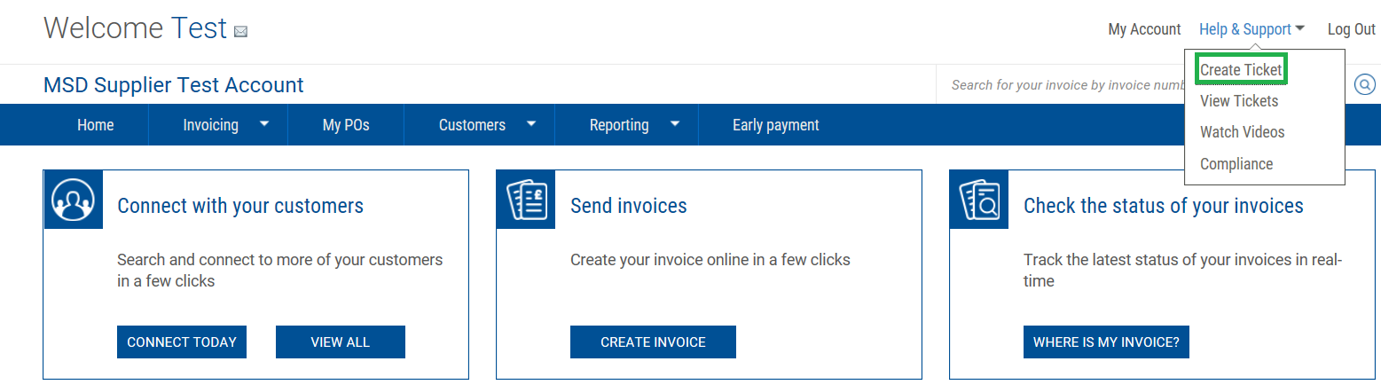
How to raise a Support Ticket in Tungsten

Slide 4
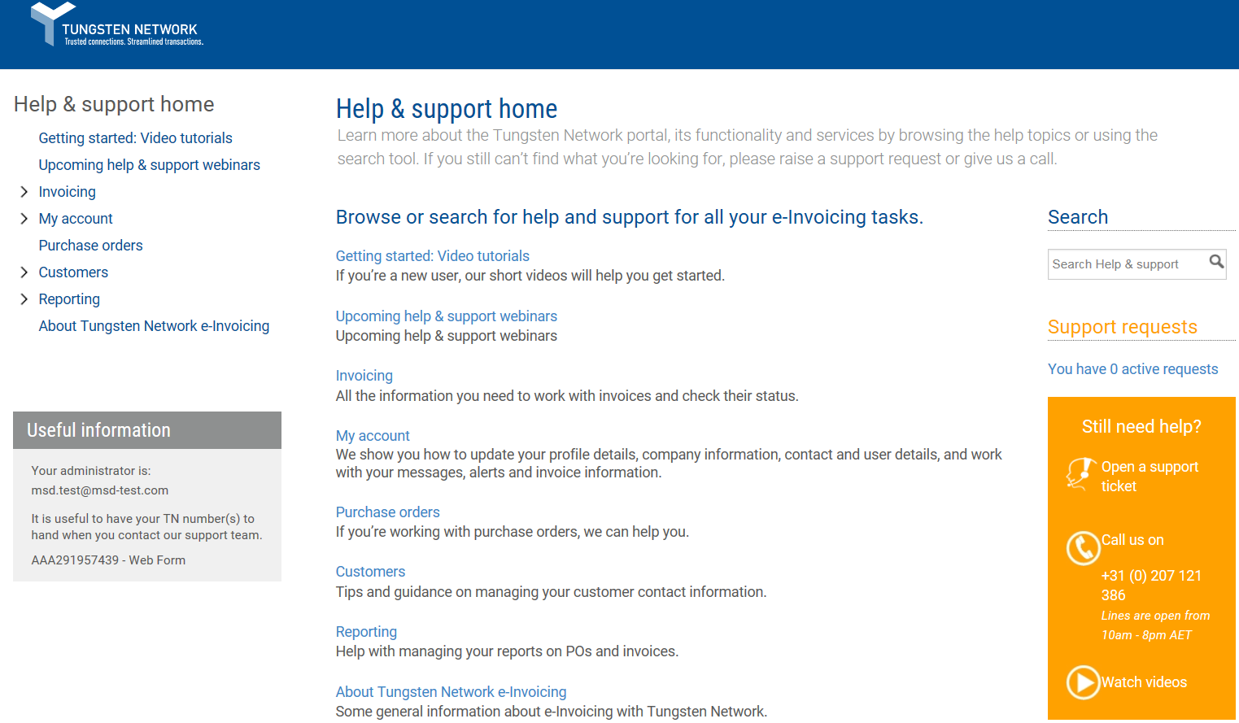
Tungsten FAQs

